Slide 1
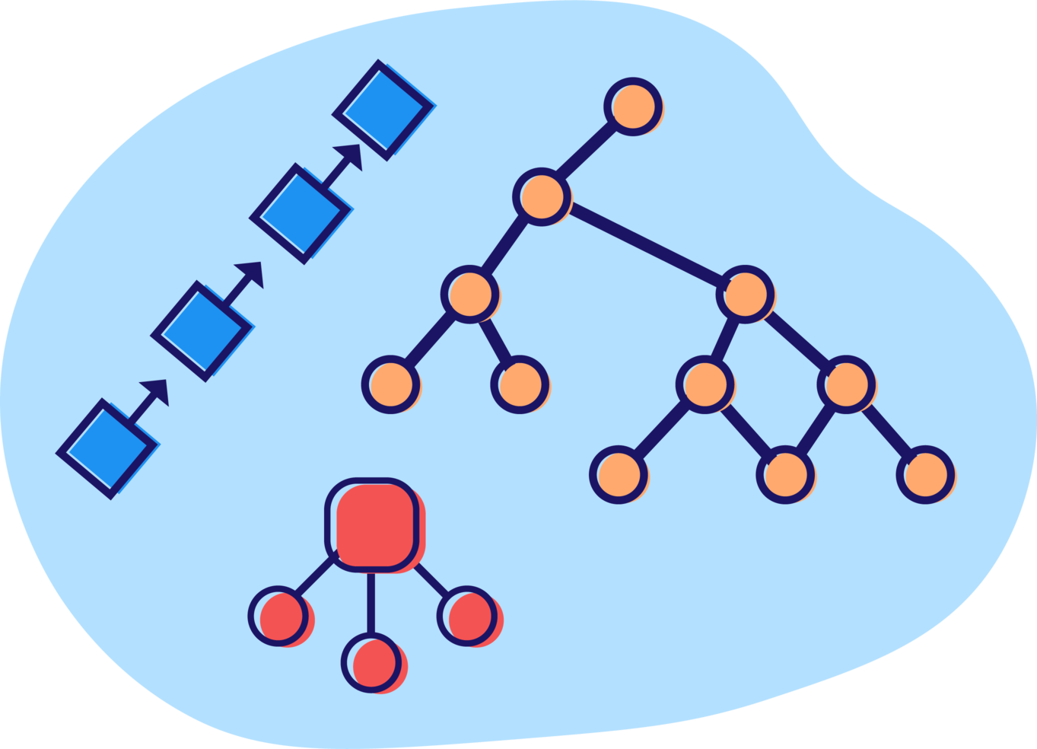
Data structure and their impact on performance
Ben KHALFALLAH héla

Slide 2

The expert's word
Networks, CPUs and Disks all hate you. On the client, you pay for what you send in ways you can't easily see.
- Alex Russell, Software Engineer on Chrome team at Google.

Slide 3
Efficient application
CPU Time
Memory Consumption
Core Web Vitals (LCP, FCP, CLS, FID, …)

Slide 4
Tackling Inefficient Applications
React DO/DON’T
Algorithms
Data Structure

Slide 5
What we’ll see ?
A simplified Memory representation
What’s a Data Structure?
Linear data structures: Array, Queue, Stack, Linked List, Doubly Linked List
Hash Tables
When to use what ?
Non-linear (advanced) data structures: Trees, Tries and Heap.

Slide 6

Let’s start

Slide 7
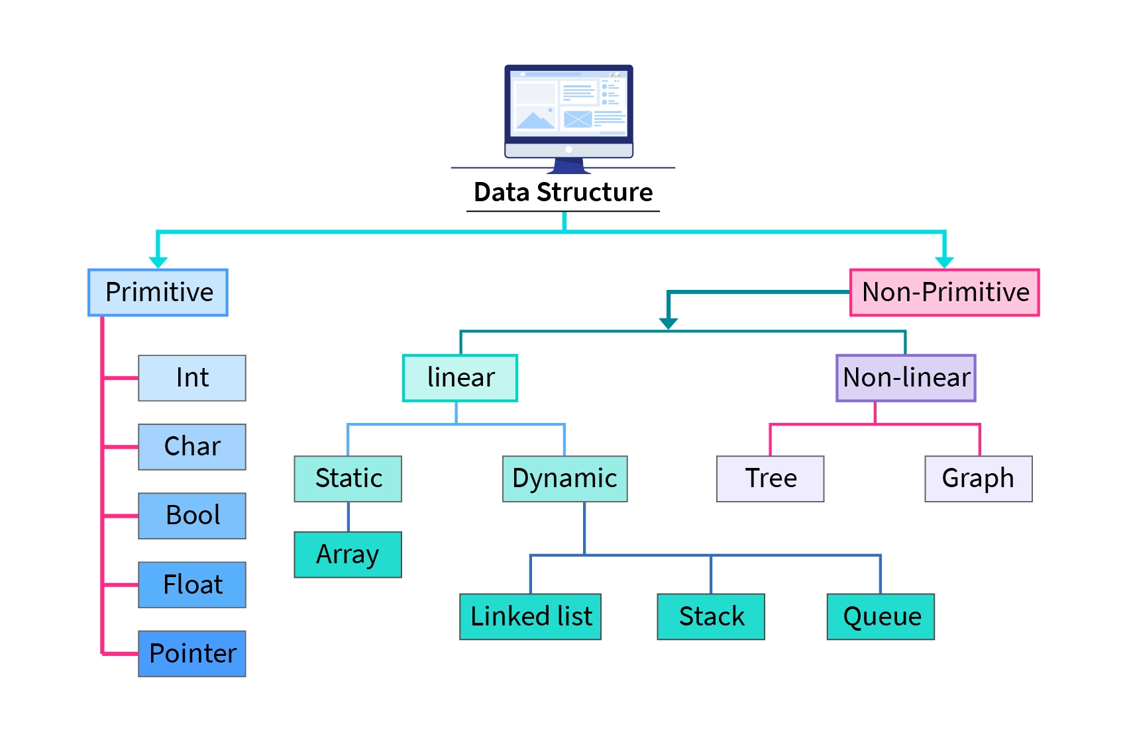
data Structures types

Slide 8

Have you ever asked the question:
why do we have all these types of data structures?

Slide 9
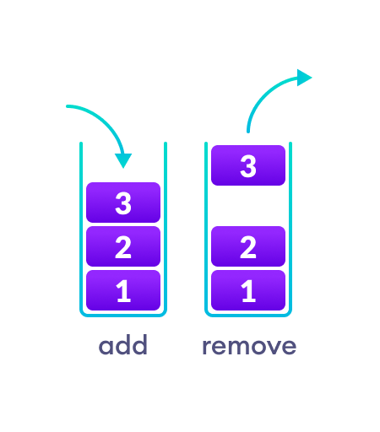
Data structures operations (crud)
Access (one item / all items)
Insert (at end / at position)
Delete (from end / from position)
Find (if exists / what location)
Sort (sort in place / create sorted version)

Slide 10
Have you ever asked the question:
does the choice of data structure affect the cost of operations?

Slide 11
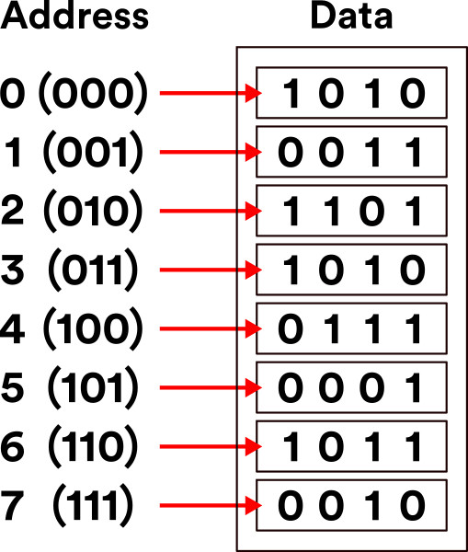
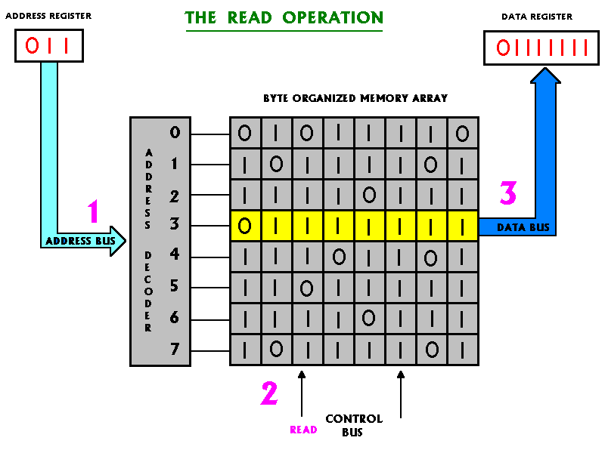
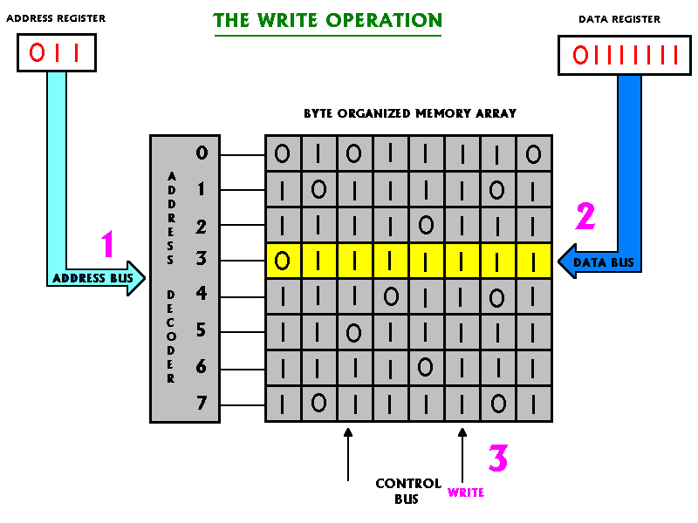
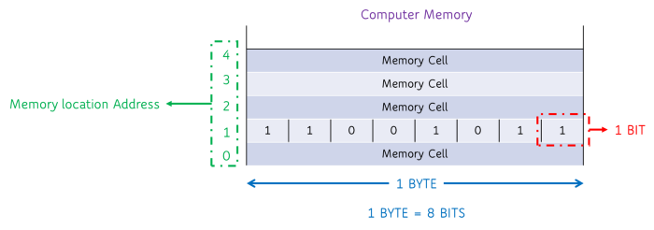
A simplified Memory representation
Bit is the basic unit of memory.
At a time, it can be either 1 (on) or 0 (off).
Computer memory is the collection of several bits.
Group of 8 bits are called byte.
Computer memory is a collection of contiguous blocks of bytes.
Individual block is called a cell (memory cell).
Each cell is associated with a unique numeric address (also called physical memory address).

Slide 12
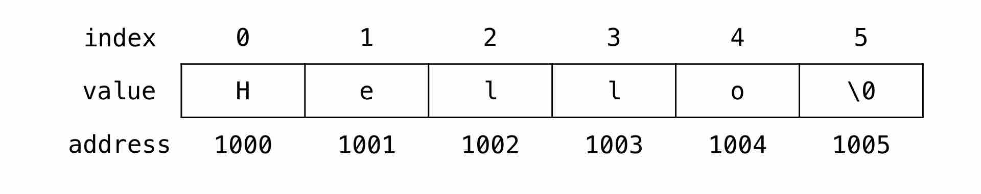
String
A character take 8 bits (= 1 byte)

Slide 13
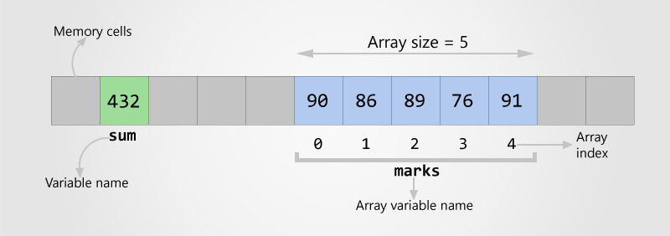
Array of integers
An integer take 8 bits (= 1 byte)

Slide 14

it's time to analyze the cost of data structures, let's go !

Slide 15
Linear data structures

Slide 16
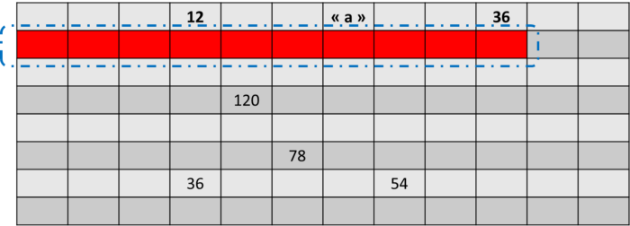
Array
When a program declares an array, it allocates a contiguous set of empty cells for use in the program.
So if we create an array meant to hold ten elements, the computer should/must find a group of ten empty cells in a row and designate it to serve as an array.
If the memory is not used, it will be easy to find ten empty placements.
However, otherwise the array cannot be allocated and some programming languages throw an OutOfMemoryException.
This is the first limitation of Arrays!

Slide 17
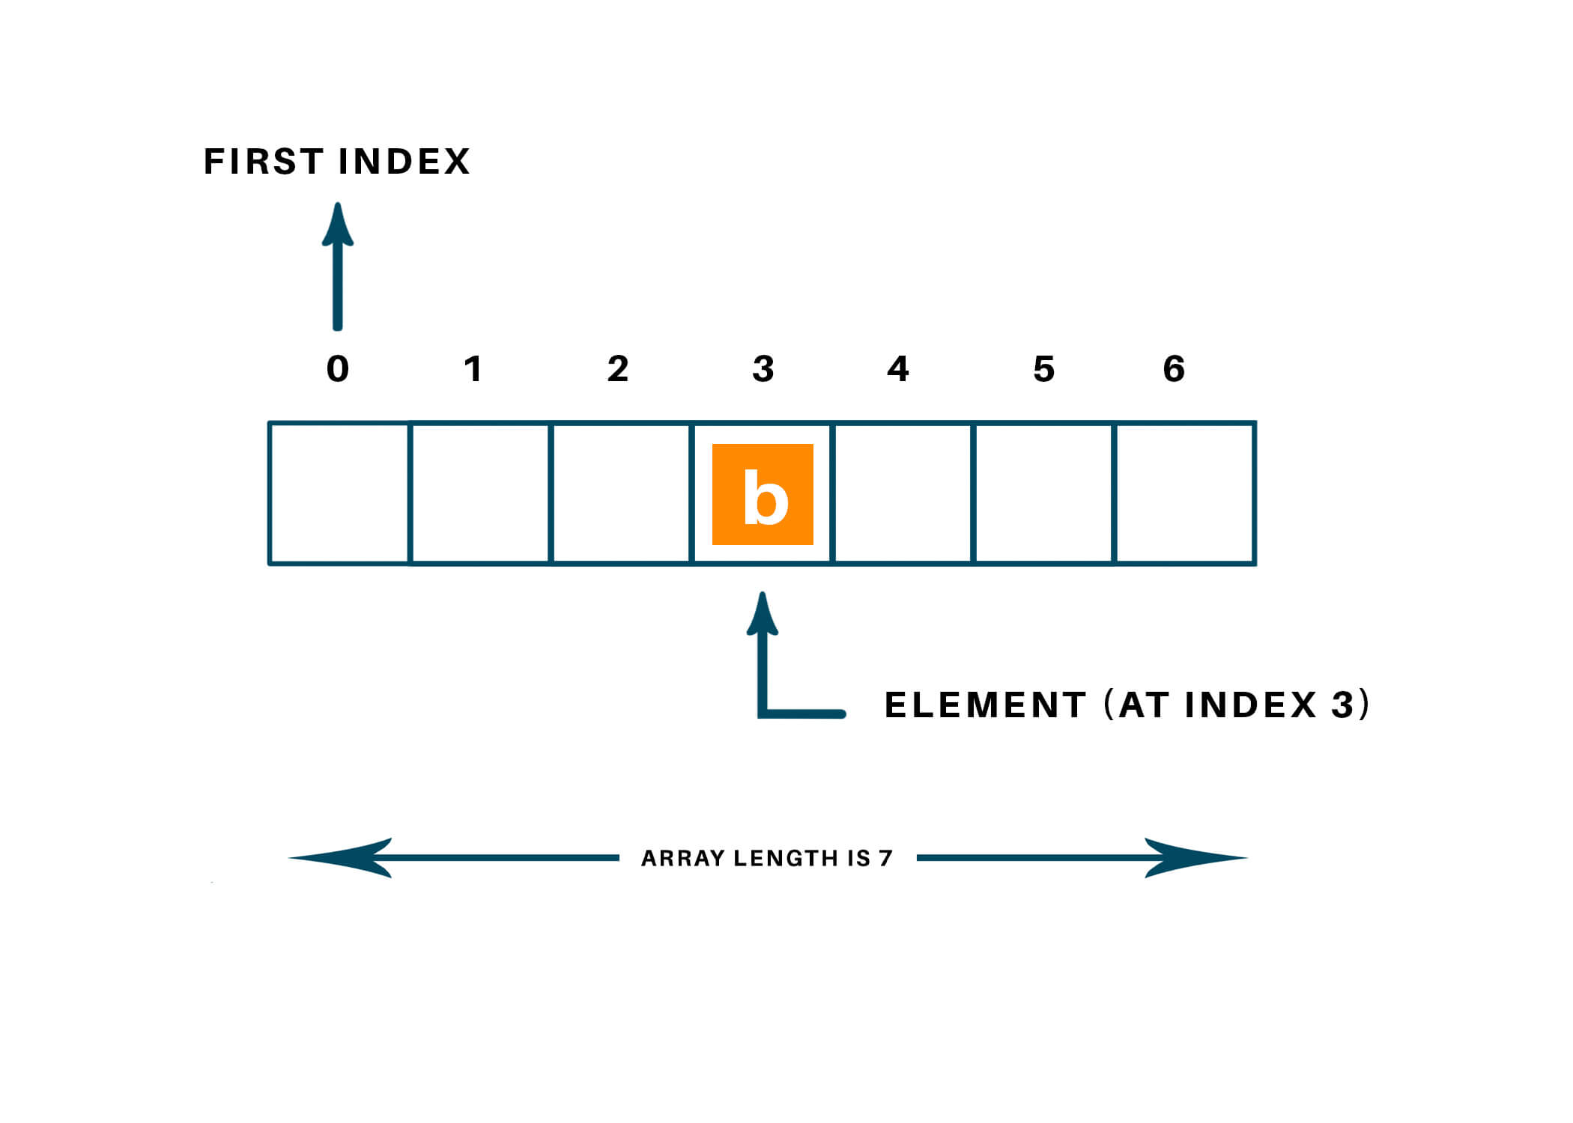
Array: read element at index
When the computer reads a value at a particular index of an array, it can jump straight to that index:
a computer can jump to any memory address in one step.
whenever a computer allocates an array, it also makes note at which memory address the begins.
then the computer can find the value at any index by performing a simple addition.
If we asked the computer to find value at index 4, the computer would simply take the memory address at index 0 and add 4.
Reading from an array is an efficient operation, since the computer can read any index by jumping to any memory address in one step.
The cost of reading an element at index = one step regardless of the index

Slide 18

Good to know
An operation that takes just one step is the fastest type of operation!

Slide 19
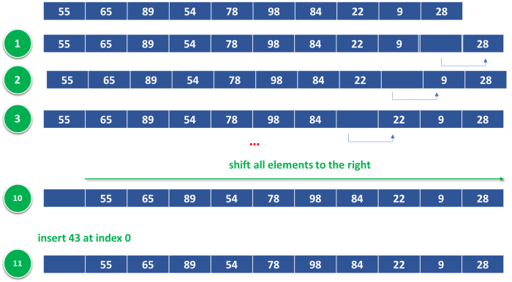
Array: Insert element at index
Insert 43 at index (0) = We need 11 steps to do this operation !

Slide 20
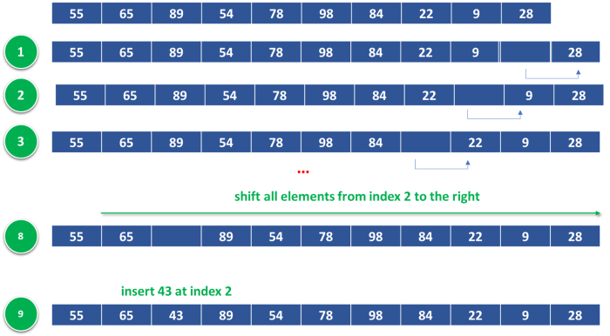
Array: Insert element at index
Insert 43 at index (2) = We need 9 steps to do this operation !

Slide 21
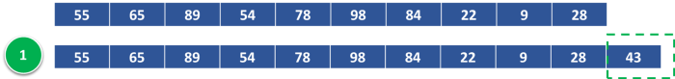
Array: Insert element at index
Insert 43 at the end = We need 1 step to do this operation

Slide 22
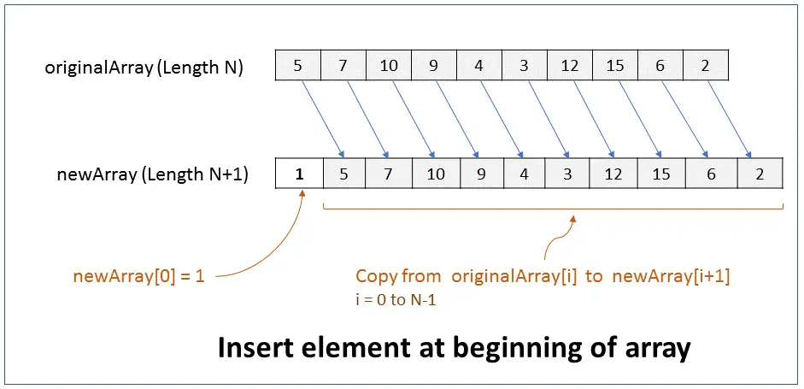
Array: Insert element at index
The worst-case scenario for insertion into array is when we insert the element at the beginning.
When inserting at the beginning of the array, we need to shift all the other values one cell to the right then finally execute the insertion step.
Insertion in a worst-case scenario take N+1 steps for an array containing N elements.
The insertion efficiency decreases further if the array is ordered. Before inserting, we need to find the specific position, then shift the elements then insert the element.
N+1 steps for an array containing N elements

Slide 23
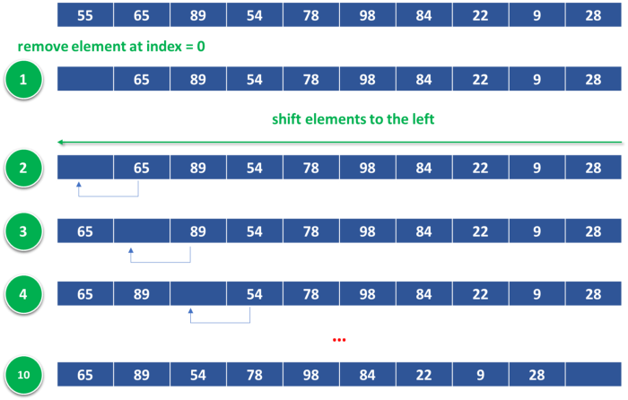
Array: remove element at index
Remove element at index (0) = We need 10 steps to do this operation !

Slide 24
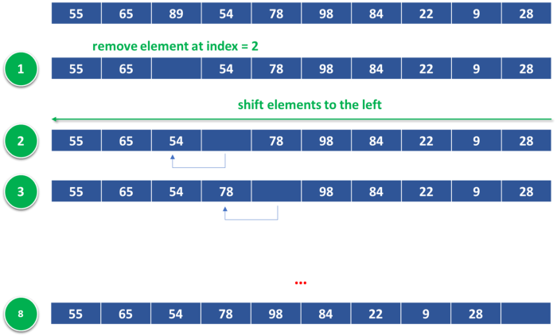
Array: remove element at index
Remove element at index (2) = We need 8 steps to do this operation !

Slide 25
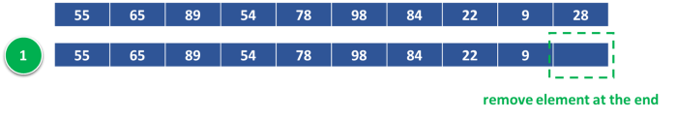
Array: remove element at index
Remove element at the end = We need 1 step to do this operation

Slide 26
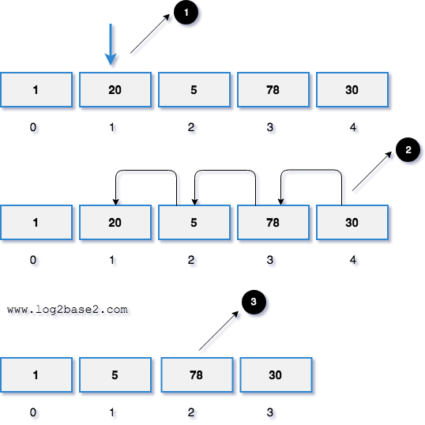
Array: remove element at index
The worst-case scenario for deletion from an array is when we delete an element from the beginning.
This is because the index 0 will become empty, and we need to shift all the remaining element to left to fill the gap.
Deletion in a worst-case scenario take N steps for an array containing N elements O(N) .
N steps for an array containing N elements

Slide 27
Array strengths
Reading from an array takes one step.
1
Inserting at the end takes one step.
2
Deleting from the end takes one step.
3

Slide 28
Array weakness
Inserting an element in a position other than the end.
1
Deleting an element in a position other than the end.
2
Searching and sorting depend on the used algorithm.
3
Need to allocate contiguous memory cells (overflow exception risk).
4

Slide 29
Array tips
Ordered arrays are useful where searches are frequent (Binary Search).
01
Unordered arrays are useful where insertions are frequent (position doesn’t matter).
02

Slide 30
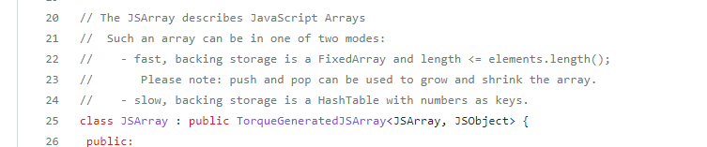
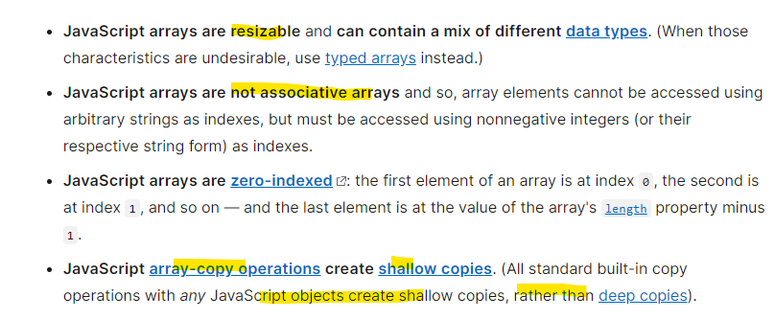
V8 javascript array
https://github.com/v8/v8/blob/master/src/objects/js-array.h
https://chromium.googlesource.com/v8/v8/+/81a3c699d6eef936452ac3d10c7c59a2c1e38c0c/src/objects/js-array.h

Slide 31
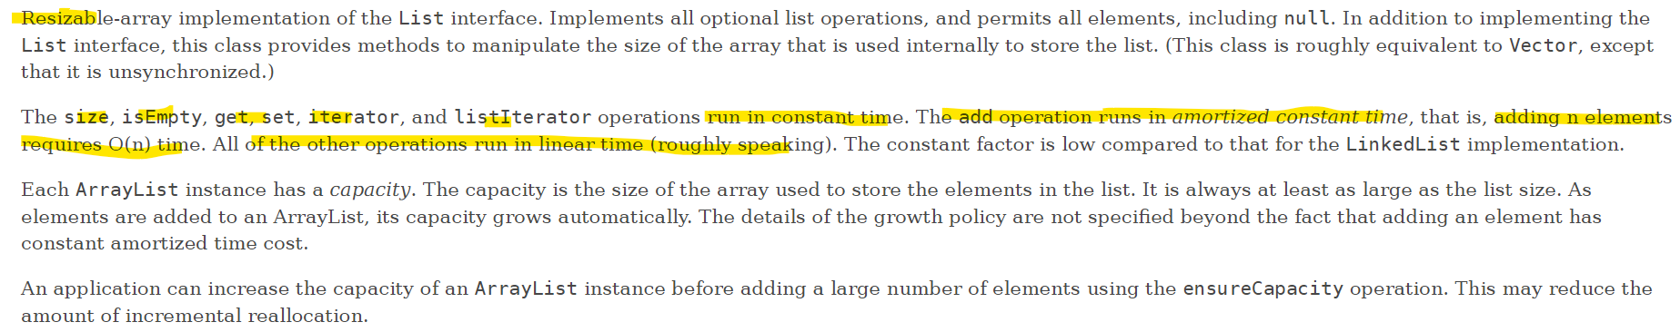
Java arrayList
https://docs.oracle.com/en/java/javase/11/docs/api/java.base/java/util/ArrayList.html

Slide 32

Weaknesses encountered with arrays give rise to several magical types of data !

Slide 33
Improving insertion and deletion at the beginning

Slide 34

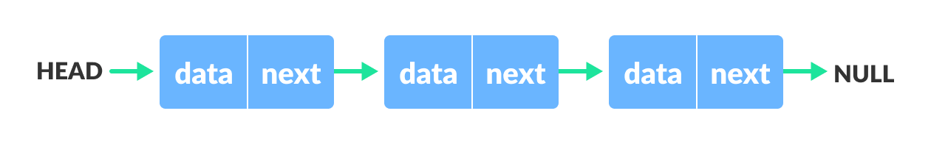
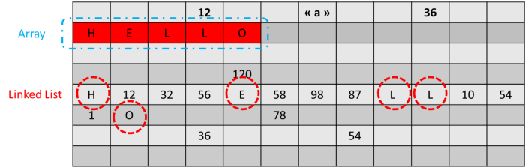
Linked list
The data from Linked Lists can be scattered across different cells throughout the computer’s memory.
Connected data that is dispersed throughout memory are called node.
Each node represents one item in the list.
Each node has a little extra information about the memory address of the next node: link.
The first node is called the “head” and the last is the “tail”.

Slide 35
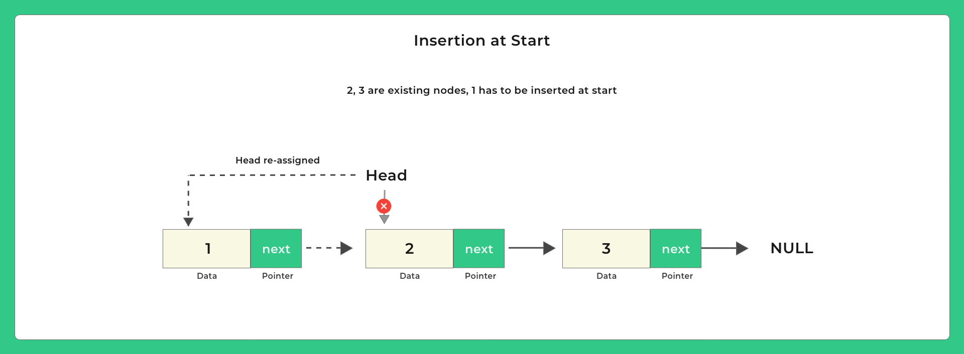

Linked list insertion
https://visualgo.net/en/list

Slide 36
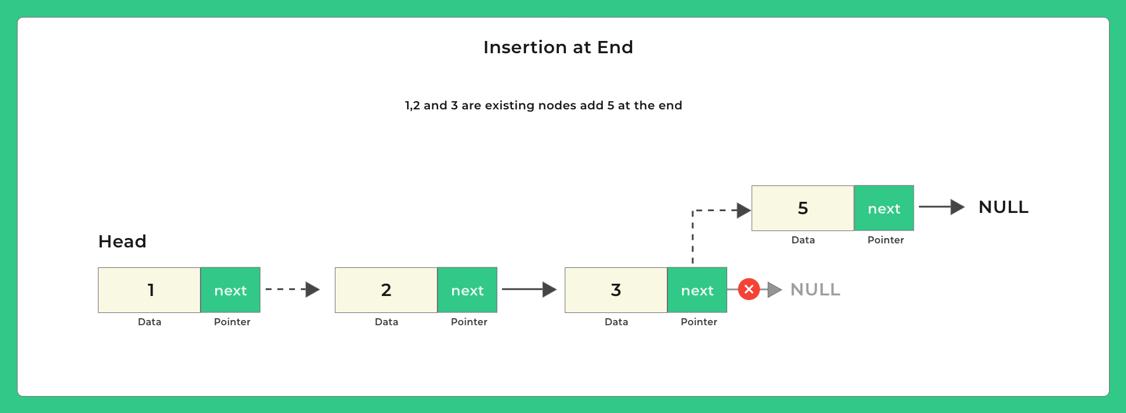
Linked list insertion
https://visualgo.net/en/list

Slide 37
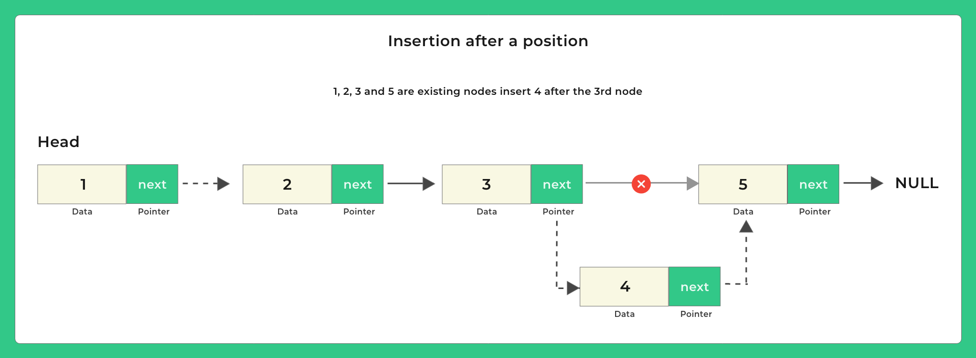

Linked list insertion
https://visualgo.net/en/list

Slide 38
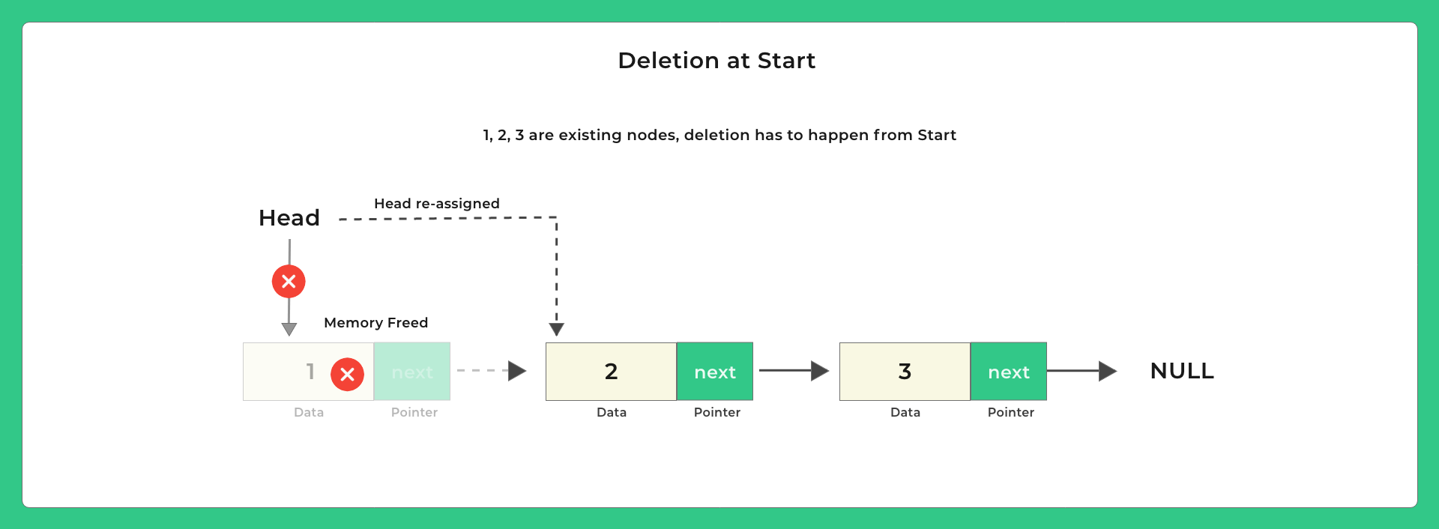

Linked list deletion
https://visualgo.net/en/list

Slide 39
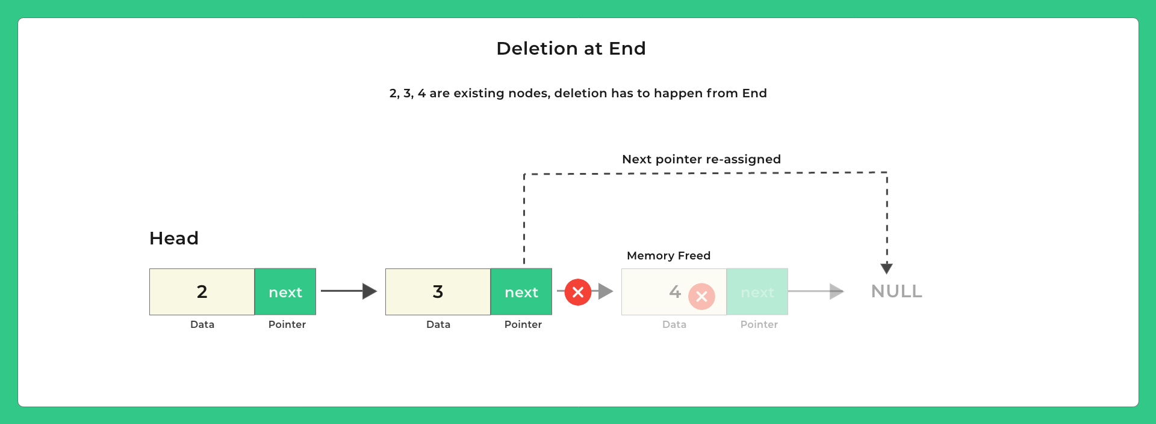
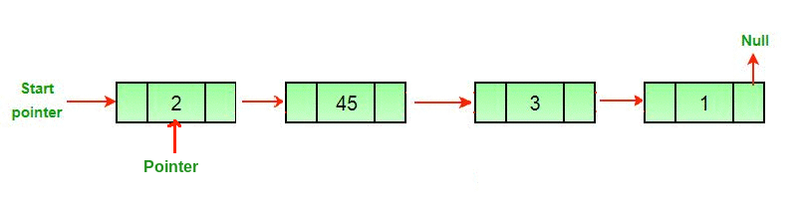
Linked list deletion
https://visualgo.net/en/list

Slide 40
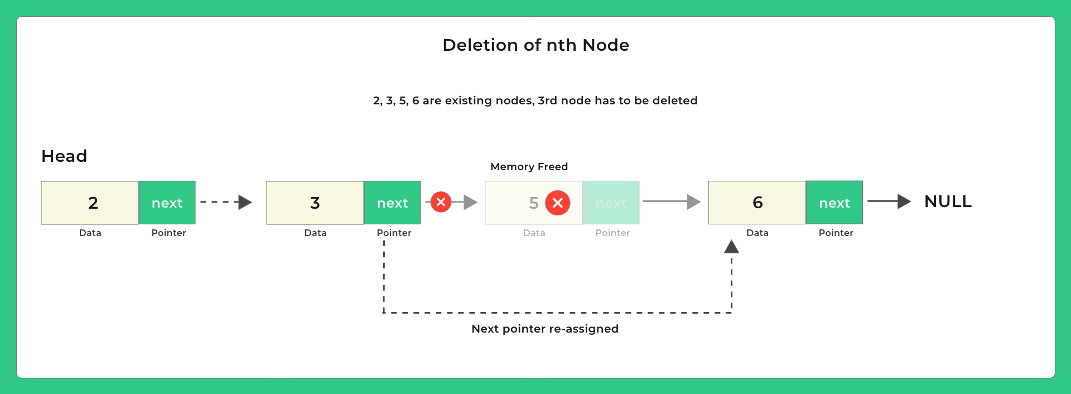
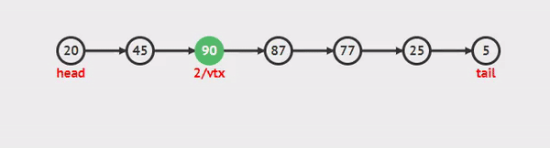
Linked list deletion
https://visualgo.net/en/list

Slide 41
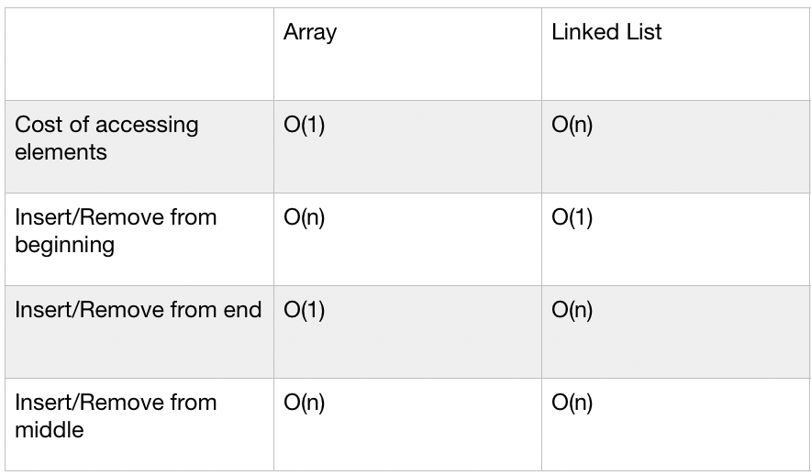
Linked list vs array

Slide 42

Linked list
Arrays favor insertion at the end, while Linked Lists favor insertion at the beginning.
Arrays favor deletion at the end, while Linked Lists favor deletion at the beginning.
Linked List is more efficient than Array when we need to insert at the beginning and read from the beginning.

Slide 43
Native implementation of linked list (java)
Doubly-linked list implementation of the List and Deque interfaces. Implements all optional list operations, and permits all elements (including null).
All of the operations perform as could be expected for a doubly-linked list. Operations that index into the list will traverse the list from the beginning or the end, whichever is closer to the specified index.
https://docs.oracle.com/javase/7/docs/api/java/util/LinkedList.html

Slide 44

Native implementation of linked list (javaScript)
There is no native implementation for Linked List !

Slide 45
Let's boost the performance of linked list now!

Slide 46
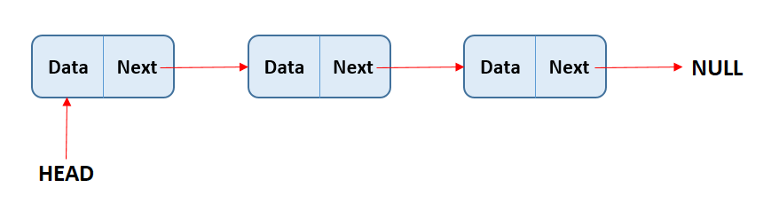
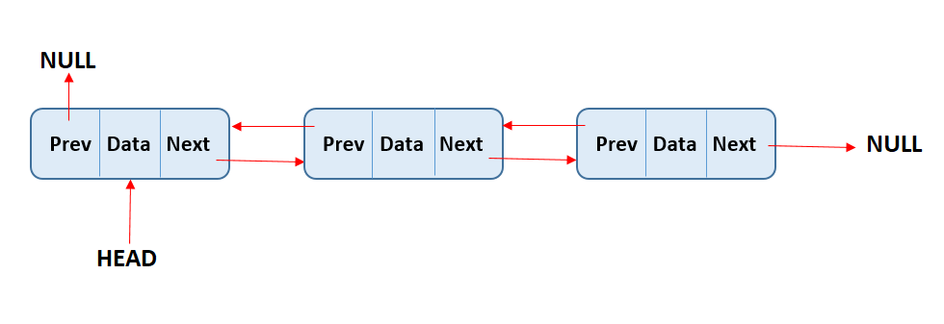
Doubly Linked List
Linked List
Doubly Linked List

Slide 47
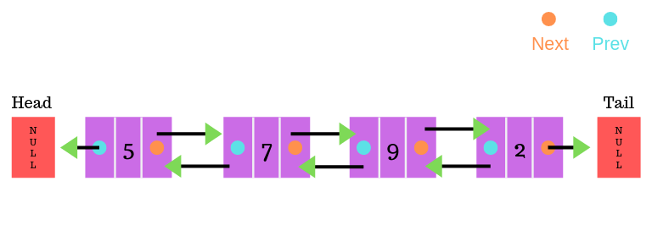
Doubly Linked List
Each node has two links: one that points to the next node and another that points to the previous node.
Doubly Linked List always keeps track of both the first and last nodes instead of just the first node.
https://visualgo.net/en/list

Slide 48
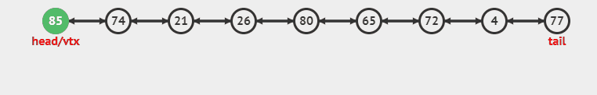
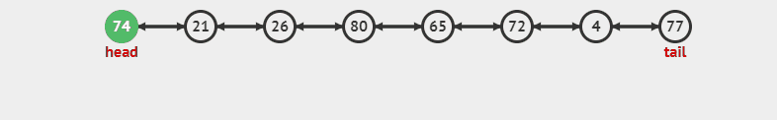
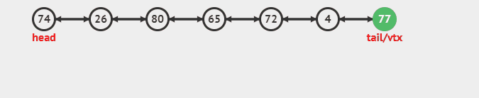
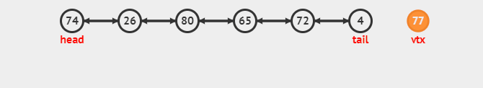
Doubly Linked List: delete & insert at the beginning or at the end
Since a Doubly Linked List always knows where both its first and last nodes are, we can access each of them in a single step O(1), amazing !
Then, like we can read, insert or delete from the beginning of the list in O(1) we can do the same from the end of the list O(1) !
With a Linked List, we can only move forward.
However, with a Doubly Linked List we can move forward and backward (from the start to the end or from the end to the start)!
https://visualgo.net/en/list

Slide 49


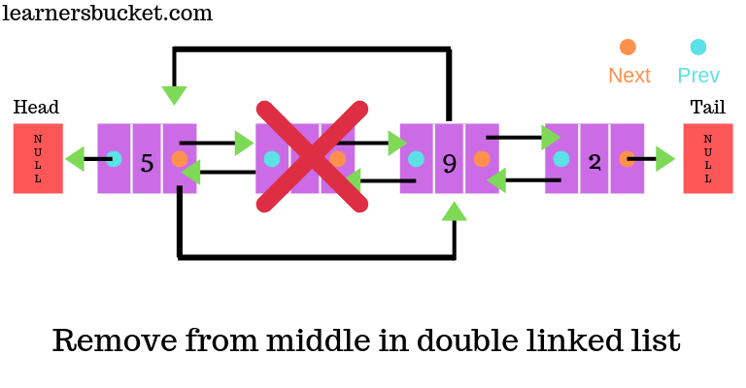
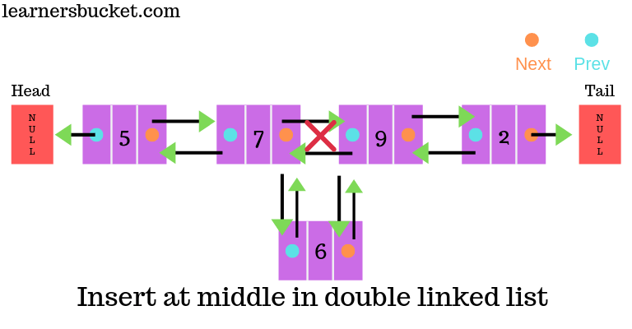
Doubly Linked List: delete & insert at position
Inserting or deleting an element from a position other than the first or the end is not efficient.
https://visualgo.net/en/list

Slide 50
Native implementation of doubly linked list (javaScript)
There is no native implementation for Doubly Linked List !

Slide 51
let's harness the magic of the doubly linked list!

Slide 52
Let's look at this request
The printer processes the jobs one after the other and in the order of their arrival.
Once a document is printed, it is removed from the waiting list (free memory).
1 | 2 | 3 | 4 | … | … | … | … | … | N
Take job in the order of their arrival
Insert at the end to keep the order of arrival
Current Job
New Job
The use of an array is expensive for this need !

Slide 53
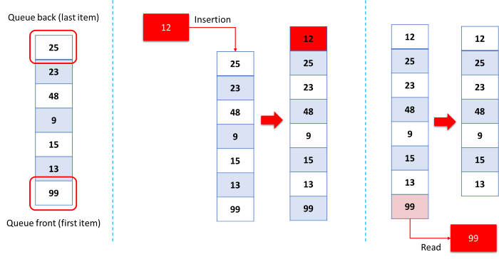
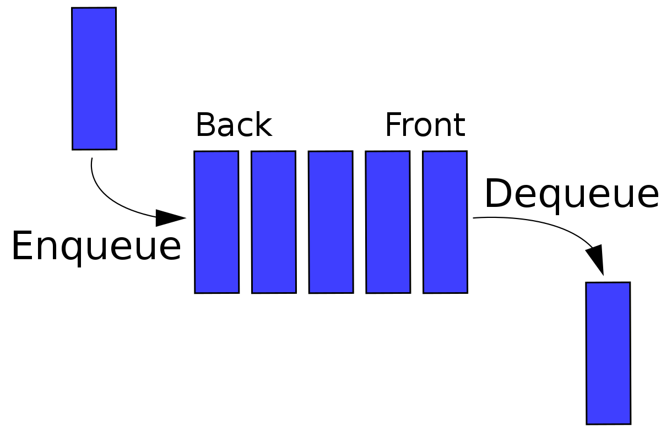
Queue to rescue
The data structure we need is the Queue.
data can be inserted only at the end.
data can be deleted only from the front.
only the element at the front can be read.
the first item added to the queue is the first item to be removed (FIFO).
Inserting new item into a queue is called enqueue.
Removing an item from a queue is called dequeuing.
The first item enqueued is the first item dequeued (FIFO).

Slide 54
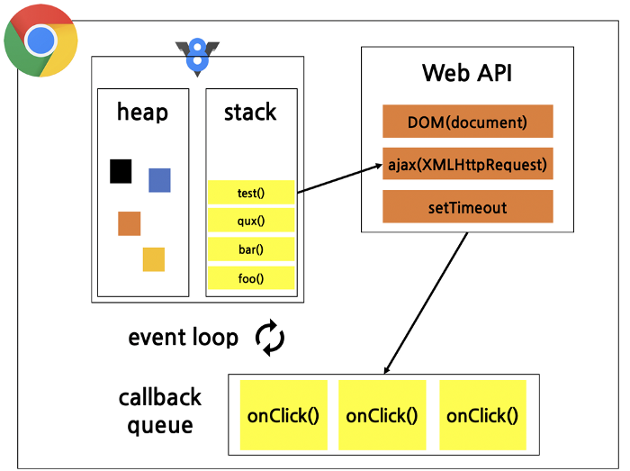
Queue real example
How JavaScript works

Slide 55
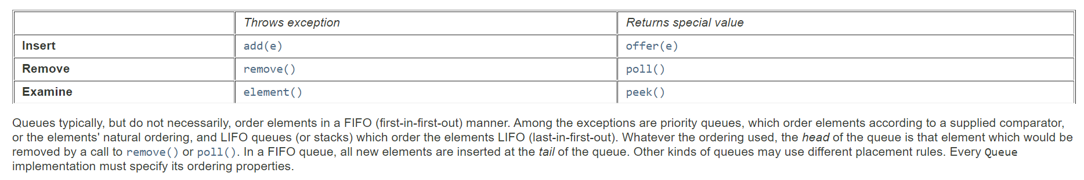
Native implementation of queue (java)
https://docs.oracle.com/javase/7/docs/api/java/util/Queue.html

Slide 56

Good to know
Java DelayQueue
Java PriorityQueue

Slide 57
Native implementation of queue (javascript)
There is no native implementation of Queue.
However we can use Array to implement a Queue.
https://developer.mozilla.org/en-US/docs/Web/JavaScript/Reference/Global_Objects/Array/shift
https://developer.mozilla.org/en-US/docs/Web/JavaScript/Reference/Global_Objects/Array/push

Slide 58
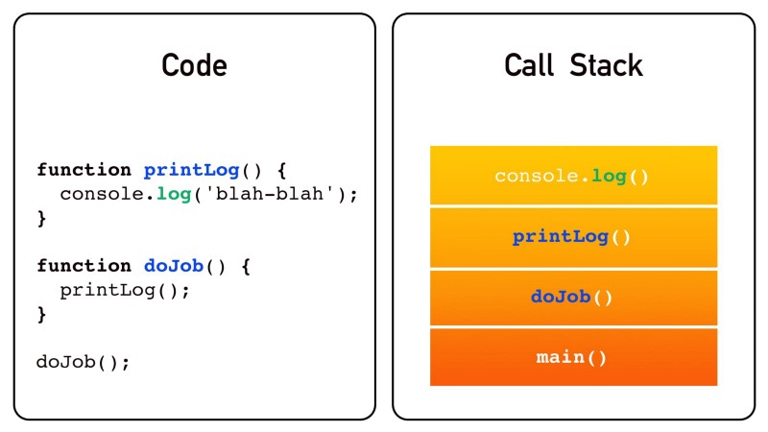
Let's look at this request
Code
Magic Data Structure

Slide 59
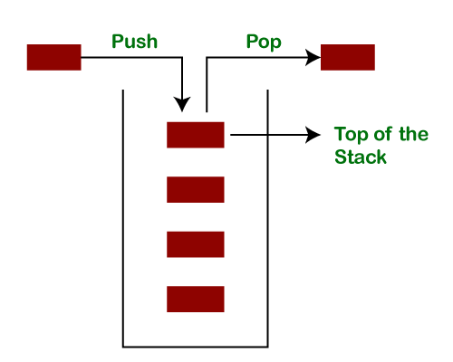
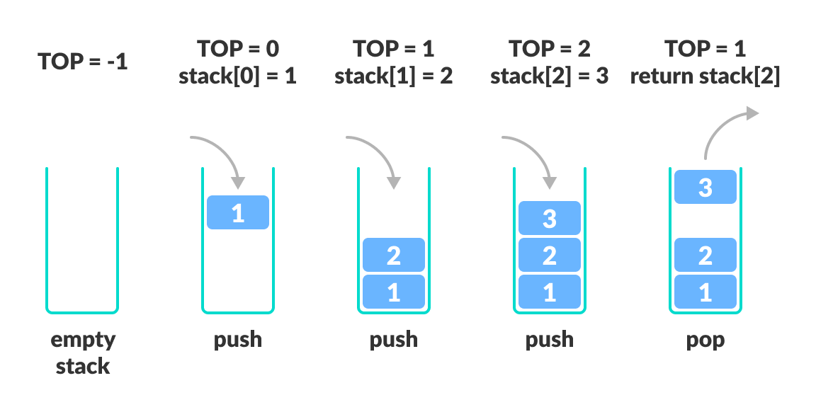
stack
Inside a Stack:
data can be inserted only at the end.
data can be deleted only from the end.
only the last element can be read (LIFO).
Inserting new item into the stack is called pushing onto the stack.
Removing an item from the top of the stack is called popping from the stack.
The last item pushed onto the stack is always the first item popped from it (LIFO).

Slide 60
stack real example
How JavaScript works

Slide 61
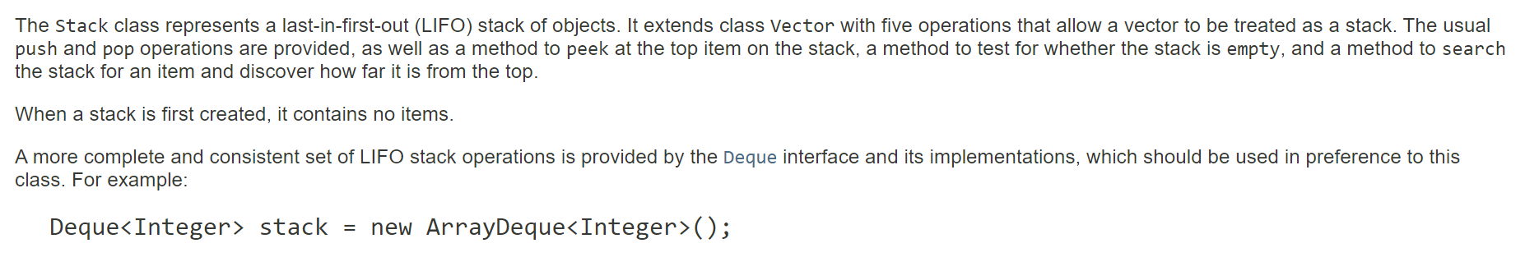
Native implementation of stack (java)
https://docs.oracle.com/javase/7/docs/api/java/util/Stack.html

Slide 62
Native implementation of stack (javascript)
There is no native implementation of Stack.
However we can use Array to implement a Stack.
https://developer.mozilla.org/en-US/docs/Web/JavaScript/Reference/Global_Objects/Array/pop
https://developer.mozilla.org/en-US/docs/Web/JavaScript/Reference/Global_Objects/Array/push

Slide 63



Tips: implementing an efficient queue or stack
https://docs.oracle.com/javase/7/docs/api/java/util/concurrent/ConcurrentLinkedQueue.html
https://docs.oracle.com/javase/7/docs/api/java/util/concurrent/LinkedBlockingQueue.html
Since Doubly Linked List can insert data on either side at O(1) as well delete on either side at O(1), they are a perfect candidate data structure to implement a Queue or a Stack !

Slide 64

Let's now discover the Hash tables!

Slide 65

Hash tables (what?)
A hash table uses a hash function to compute an index, also called a hash code, into an array of buckets or slots, from which the desired value can be found.
During lookup, the key is hashed and the resulting hash indicates where the corresponding value is stored.
So, accessing to a value by its key take one step O(1).
For every key-value pair, each value is stored at the index of the key, after the key has been hashed.

Slide 66

Be carefull
We can do O(1) lookups only when using a key to find the value. If we use a value to find its associated key, we cannot take advantage of the Hash Table's magic lookup !

Slide 67

Hash function (collision)
Hash function must convert the same string to the same number every single time it’s applied.
Functions that use random numbers or the current time as part of their calculation are invalid.
When the hash function generates the same index for multiple keys, there will be a conflict (what value to be stored in that index). This is called a hash collision.
A good hash function may not prevent the collisions completely however it can reduce the number of collisions.
Hash collisions could lead to a worst case of 𝒪(n). That means that inserting n entries can take up to 𝒪(n²).

Slide 68

Collision Resolution with Quadratic Probing
Allow each slot to hold a reference to a collection (or chain) of items.
Chaining allows many items to exist at the same location in the hash table.
When collisions happen, the item is still placed in the proper slot of the hash table.
As more and more items hash to the same location, the difficulty of searching for the item in the collection increases.

Slide 69

Hash tables (dynamic resizing)
Repeated insertions cause the number of entries in a hash table to grow, which consequently increases the load factor.
To maintain the amortized O(1) performance of the lookup and insertion operations, a hash table is dynamically resized and the items of the tables are rehashed into the buckets of the new hash table.
The hashes of the inputs are changed on resizing and the algorithm cannot simply copy data from the old storage to the new.
If a hash table becomes "too empty" after deleting some elements, resizing may be performed to avoid excessive memory usage.

Slide 70

Hash-flooding DoS
https://isdanni.com/hash-flooding/
https://v8.dev/blog/hash-flooding

Slide 71

JavaScript Map, Set, WeakSet, and WeakMap
ECMAScript 2015 introduced several new data structures such as Map, Set, WeakSet, and WeakMap, all of which use hash tables under the hood.
https://v8.dev/blog/hash-code

Slide 72

javaScript dictionary vs map
https://mathiasbynens.be/notes/shapes-ics
Object/Dictionary: A data structure in which data is stored as key value pairs. In an object the key has to be a number, string, or symbol. The value can be anything so also other objects, functions, etc. An object is a nonordered data structure, i.e. the sequence of insertion of key value pairs is not remembered.
ES6 Map: A data structure in which data is stored as key value pairs (using a hash function). In which a unique key maps to a value. Both the key and the value can be in any data type. A map is an iterable data structure. This means that the sequence of insertion is remembered and that we can access the elements in e.g. a for..of loop.
Use Object for records where you have a fixed and finite number of properties/fields known at author time, such as a config object. And anything that is for one-time use in general.
Use Map for dictionaries or hash maps where you have a variable number of entries, with frequent updates, whose keys might not be known at author time, such as an event emitter.
https://developer.mozilla.org/en-US/docs/Web/JavaScript/Reference/Global_Objects/Map#Objects_and_maps_compared
https://www.zhenghao.io/posts/object-vs-map

Slide 73

Java hash table
https://docs.oracle.com/javase/8/docs/api/java/util/Hashtable.html

Slide 74

Java hash map
https://docs.oracle.com/javase/8/docs/api/java/util/HashMap.html

Slide 75
Good to know
Java ConcurrentHashMap
A hash table supporting full concurrency of retrievals and high expected concurrency for updates.
This class obeys the same functional specification as Hashtable, and includes versions of methods corresponding to each method of Hashtable.
However, even though all operations are thread-safe, retrieval operations do not entail locking, and there is not any support for locking the entire table in a way that prevents all access.
This class is fully interoperable with Hashtable in programs that rely on its thread safety but not on its synchronization details.

Slide 76

Hash tables (cost)
Collision

Slide 77
Non-Linear (advanced) data structures

Slide 78


tree
Applications: File Systems, Directory & Subdirectories, DOM, Storing hierarchical data.
Types: General tree, Binary tree, Balanced tree, Binary search tree, Red Black Tree, AVL Tree.
https://visualgo.net/en/bst

Slide 79


Binary search tree

Slide 80


Tries
Tries are used in dictionary word searches, spell-checking and in search engines by making auto-suggestions.
https://www.enjoyalgorithms.com/blog/introduction-to-trie-data-structure

Slide 81

heap
A heap is a tree-based data structure in which all the nodes of the tree are in a specific order.
Max Heap: In this type of heap, the value of parent node will always be greater than or equal to the value of child node across the tree and the node with highest value will be the root node of the tree.
Min Heap: In this type of heap, the value of parent node will always be less than or equal to the value of child node across the tree and the node with lowest value will be the root node of tree.
Heap data structure is efficient whenever we need to retrieve the largest or smallest element.
The accessing of elements from the root of a tree has a time complexity of O(1).
Heap is used in the construction of priority queues.
Heap Sort is used in systems concerned with security and embedded systems, such as the Linux Kernel.
https://github.com/torvalds/linux/blob/master/lib/sort.c#L200
https://en.wikipedia.org/wiki/Binary_heap
https://visualgo.net/en/heap

Slide 82
When to use what ?

Slide 83

when to use what?

Slide 84

when to use what?

Slide 85

Let’s wrap it all up

Slide 86

the expert's word
“Data structures and algorithms are more than abstract concepts. Mastering them enables you to write code that is efficient, leading to software that runs faster and consumes less memory. This is a big deal for today’s software applications, which exist on increasingly mobile platforms and handle increasingly greater amounts of data.”
— Data structures and algorithms

Slide 87
Golden rule
Correct
Clean
Performant

Slide 88
Golden rule
Code
Test
Measure
Optimize
Repeat

Slide 89
Golden rule
Challenge code
(algorithm, data structure, react, Core web vitals)
Challenge Pull Request
(peer review)
Improve

Slide 90




further reading

Slide 91

Thank you !
Any Question ?

Slide 92


